Slide 1
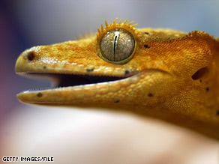
Gecko Adhesives
By Michelle Xie & Alisa Tang

Slide 2
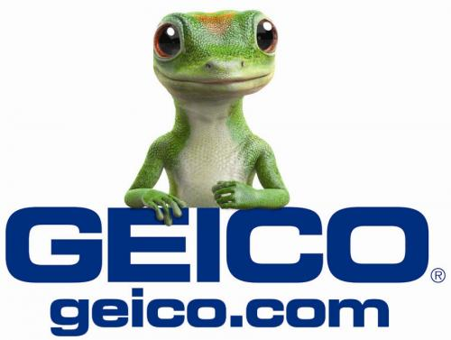
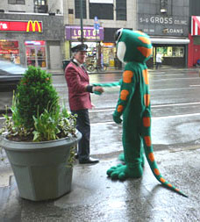
WHAT?!?!

Slide 3
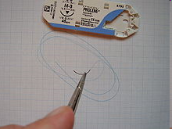
What Are Gecko Bandaids & Tapes?
Bandages & adhesives using new technology based on gecko feet and Van der Waals forces
Could eventually be used in surgery in place of sutures
Could change the adhesive industry forever…

Slide 4
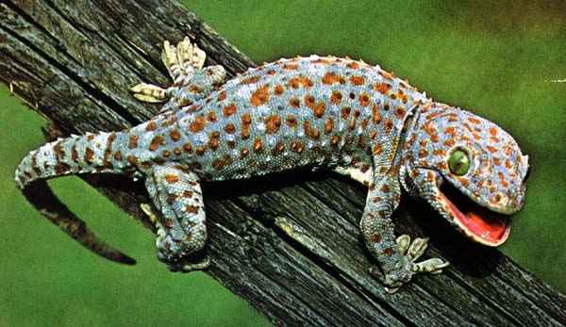
How Are Geckos Involved in the Making of These Adhesives?
The adhesives mimic the way geckos stick to walls with their feet, using contact splitting

Slide 5
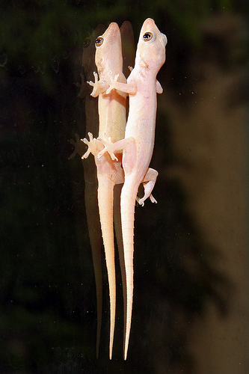
Gecko Van der Waals Forces
So, what are they again?
Recall that van der Waals forces are the intermolecular forces between particles, excluding covalent or ionic bonds
  London dispersion forces
  Dipole-dipole forces
  Hydrogen bonding
In the gecko, the adhesion caused by the van der Waals forces is more dependent on geometry than chemical composition

Slide 6
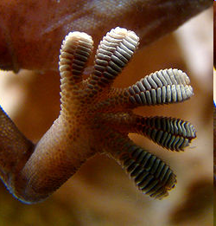
Journey Through Discovery: How Geckos Stick to Ceilings
For many years, scientists have wondered how geckos manage to stick to ceilings.
It has been debated since the 19th century
Hypotheses: glue, friction, suction, electrostatics, micro-interlocking and intermolecular forces
Eventually narrowed down to intermolecular forces

Slide 7
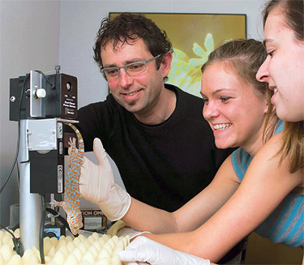
Journey Through Discovery: How Geckos Stick to Ceilings
It was at Kellar Autumn’s lab at Lewis and Clark College in Oregon in 2000 when scientists first discovered how
Each gecko toe is coated with approximately half a million bristles called setae, which form rows called lamellae.
Each setae branches into over 1000 split ends called spatulae, and the density of the setae is over 3 million per square inch!
The spatulae are attracted to surfaces by van der Waals forces

Slide 8
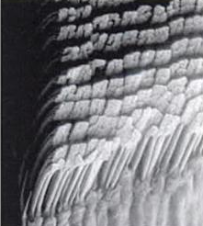

Journey Through Discovery: How Geckos Stick to Ceilings
In fact, a single gecko foot can suspend a 40 lb weight
There are about 850 species of gecko, and each species has a different type of seta.
1 million setae can suspend a small child (45 lb)
Spatulae are approximately 200nm wide, and they are invisible except under an electron microscope.
One setae, which has a diameter that is 1/100 the diameter of human hair, can lift an ant. 20 microNewtons = 20 mg.

Slide 9
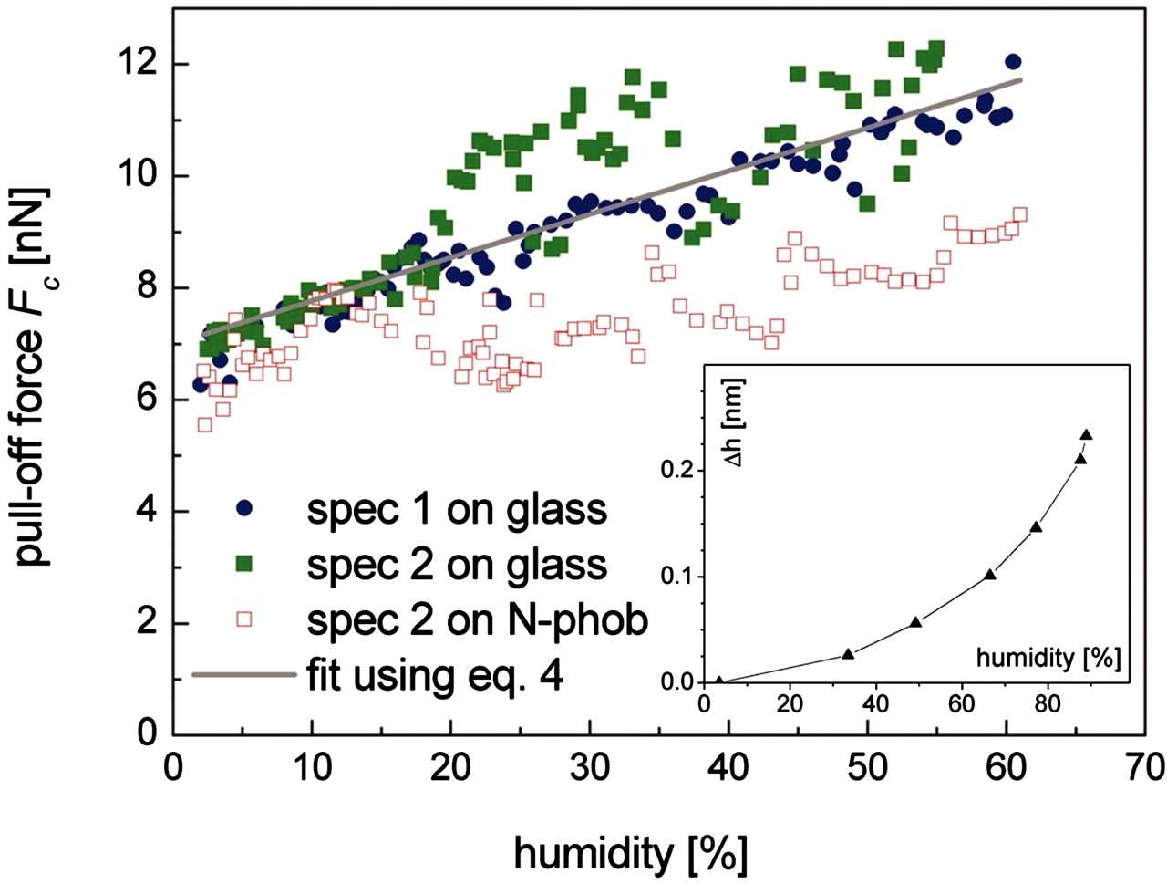
Journey Through Discovery: How Geckos Stick to Ceilings
As recently as 2005, scientists have discovered that adhesiveness of geckos increases with humidity as well
The more hydrophilic the substance the gecko is attaching to, the greater the adhesive force
Not only does the gecko use van der Waals forces, but it also uses capillary forces to adhere to things

Slide 10
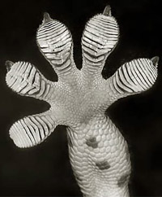
Properties of the Gecko Foot
One of the most amazing properties of the gecko foot is that it is an adhesive that can let go and be reused again
Another property is that the gecko foot doesn't get dirty
        A lab conducted by a scientist named Holland showed that isolated setae are self-cleaning
        Autumn's showed that this was because setae can only stick to a few particles at a time

Slide 11
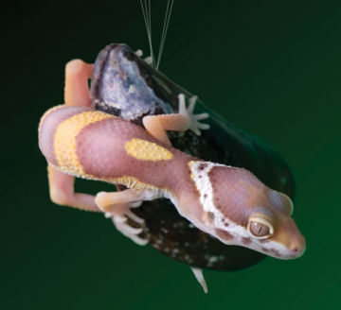
Journey Through Discovery: Challenges
However, there was a problem. Most bandages do not last long when exposed to water
Also, many researchers have had problems replicating the reversible property of gecko feet
At Northwestern University, Professor Phillip B. Messersmith, a professor of biomedical engineering, and Haeshin Lee, one of Messersmith’s graduate students, created a new adhesive material called “geckel” combining the sticking powers of the gecko and mussel in 2007.
Gecko = sticky on land
Mussel = sticky in water
A gecko and mussel hanging
out together

Slide 12
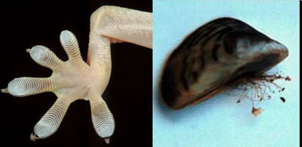
Geckel
“I was reading a research paper about the drop of adhesion in geckos when underwater, and it hit me—maybe we could apply what we know about mussels to make gecko adhesion work underwater!” said Messersmith
Uses for geckel: replacement of sutures for wound closure, water-resistant adhesive for bandages and water-proof drug-delivery patches
Remains sticky through 1000 contact and release cycles

Slide 13
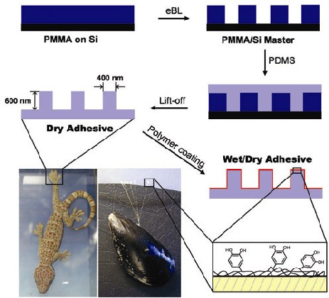
Geckel (cont)
Messersmith and Lee nanofabricated arrays of silicone pillars and then they coated the pillars with a very thin layer of a synthetic polymer
  15 times more effective with the mussel powder
The mussel powder uses an amino acid called 3, 4-dihydroxyphenylalanine (DOPA), an important component of the “glue” proteins of mussels

Slide 14
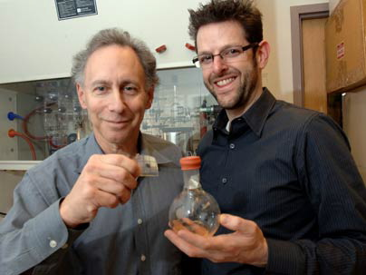
Journey Through Discovery: Challenges
In order to make gecko bandages safe for medical uses, they needed to be biocompatible, biodegradable, and elastic enough for internal organs
Jeffrey Karp and Robert Langer, two scientists from MIT, led a research team that was the first to develop a material suitable for medical uses, made of “biorubber”
First tape-based medical adhesive

Slide 15
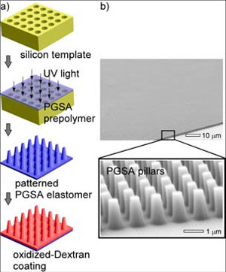
Gecko Bandage
Karp and Langer used micropatterning technology to shape the biorubber into nanoscale hills and valleys, until they found the one that stuck the best
Then they coated it with a thin layer of sugar-based glue
The nanopillars are one hundredth the thickness of a human hair
They are not meant to be removed
They will dissolve within the body over time, and this can be tweaked
Could be ready for human trials in 2-5 years

Slide 16
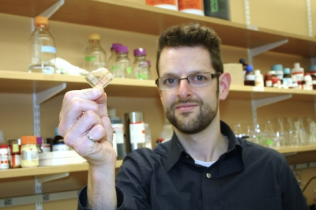
Gecko Bandage Benefits
“Sutures are very difficult to place within laparoscopic procedures. When working in very small spaces it's difficult to tie a knot, ” said Karp.
Other glue-based surgical tapes are available, but are not flexible nor waterproof

Slide 17
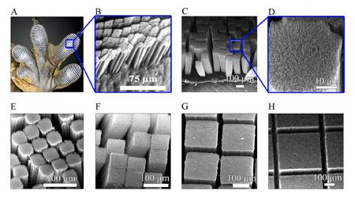
Beyond Nature
Geckos cannot stick to a few extremely smooth surfaces, such as Teflon
Pulickel Ajayan, a Professor at Rensselaer Polytechnic Institute was part of a research team that created an adhesive that can even stick to Teflon, yet retains the ability of geckos to stick and unstick!

Slide 18
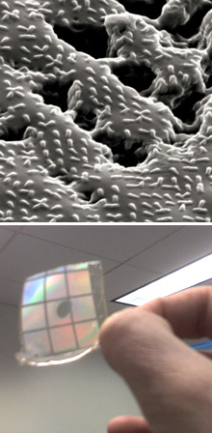
Different From Other Adhesives
According to Ron Fearing, a UC Berkeley professor, “What sets this new gecko-inspired adhesive apart from the others created thus far is that it is directional, only “sticking” when it slides along a smooth surface, not when it is pressed down.”
“This difference is critical because if you’re climbing up vertical surfaces, you can’t afford to use a lot of energy pressing down into the surface to stick,” he said.

Slide 19
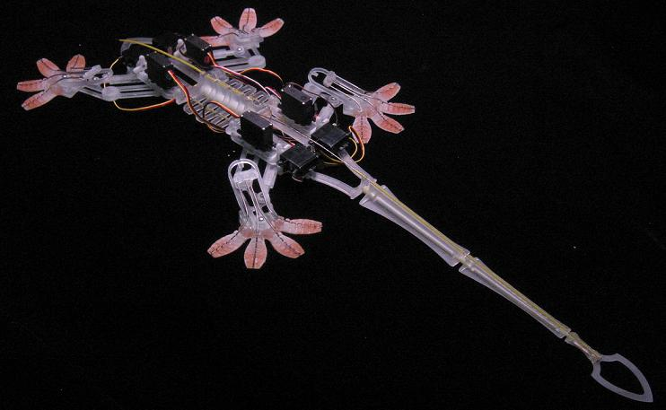
Other Inventions
Robert Full built a robot that can climb walls, called Mecko-Gecko
Andre Geim, at the University of Manchester, invented “gecko tape”, a dry, self-cleaning adhesive
At Bell Labs, an adhesive to reversibly cement microchips together was fabricated.

Slide 20
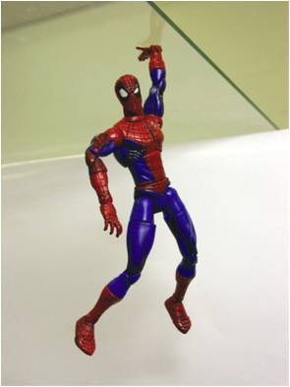
Uses
Gecko bandage
Replace sutures and staples
Coated with drugs: anti-inflammatories, antibiotics, or homing targets for stem cells
Feet for wall-climbing robots, or robots that can climb any terrain
Dry, reversible adhesive in electronic devices
Replace joints in manufactured goods
Adhesive in outer space
Superman suit

Slide 21
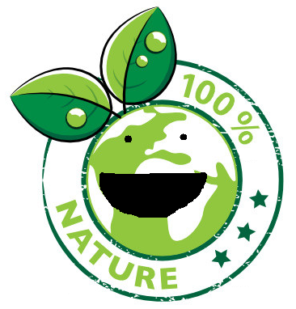

Our Opinion
Well nature is amazing. We need to take some lessons from it, because there is so much more we can learn.
Gecko bandages are effective and don’t hurt anyone.
There are no controversies because no lives are hurt in the production and usage (so far) of the gecko bandage.
It has a lot of potential.

Slide 22
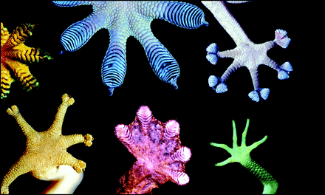
The End

Slide 23
Works Cited
Autumn, Kellar. "How Geckos Stick to Walls." Autumn Lab. 2003. Web. 5 June 2010. <http://geckolab.lclark.edu/dept/geckostory.html>.
"Climbing The Walls? New Adhesive Mimics Gecko Toe Hairs." Science Daily: News & Articles in Science, Health, Environment & Technology. 30 Jan. 2008. Web. 07 June 2010. <http://www.sciencedaily.com/releases/2008/01/080129201546.htm>.
Dougherty, Elizabeth. "MIT Creates Gecko-inspired Bandage." MIT. 18 Feb. 2008. Web. 07 June 2010. <http://web.mit.edu/newsoffice/2008/adhesive-0218.html>.
"Gecko Tech for In Vivo Bandages." Medgadget.com -- Internet Journal of Emerging Medical Technologies. 19 Feb. 2008. Web. 2 June 2010. <http://medgadget.com/archives/2008/02/gecko_tech_for_in_vivo_bandages.html>.
"Gecko-inspired Dissolving Bandage Has Nanoscale Hills And Valleys." Science Daily: News & Articles in Science, Health, Environment & Technology. 19 Feb. 2008. Web. 3 June 2010. <http://www.sciencedaily.com/releases/2008/02/080218172439.htm>.
"Hairy Feet Stick Better To Wet Ceilings." Science Daily: News & Articles in Science, Health, Environment & Technology. 10 Nov. 2005. Web. 07 June 2010. <http://www.sciencedaily.com/releases/2005/11/051110090338.htm>.
Highfield, Roger By. "Gecko Inspired Waterproof Adhesive Bandage - Telegraph." Telegraph.co.uk: News, Business, Sport, the Daily Telegraph Newspaper, Sunday Telegraph - Telegraph. 18 Feb. 2008. Web. 31 May 2010. <http://www.telegraph.co.uk/science/science-news/3325871/Gecko-inspired-waterproof-adhesive-bandage.html>.
Kellan, Ann. "Geckos' Feet Inspire New High-tech Bandage - CNN.com." CNN.com - Breaking News, U.S., World, Weather, Entertainment & Video News. 13 Mar. 2008. Web. 2 June 2010. <http://www.cnn.com/2008/TECH/03/12/gecko.bandage/index.html>.
"Nanotube Adhesive Sticks Better Than A Gecko's Foot." Science Daily: News & Articles in Science, Health, Environment & Technology. 20 June 2007. Web. 6 June 2010. <http://www.sciencedaily.com/releases/2007/06/070619083554.htm>.
Steenhuysen, Julie. "Team Makes Gecko-inspired Adhesive Bandage| Reuters." Business & Financial News, Breaking US & International News | Reuters.com. 18 Feb. 2008. Web. 1 June 2010. <http://www.reuters.com/article/idUSY1561238420080218>.
"Sticky Questions Tackled In Gecko Research." Science Daily: News & Articles in Science, Health, Environment & Technology. 2 Jan. 2008. Web. 07 June 2010. <http://www.sciencedaily.com/releases/2007/12/071220133448.htm>.
"Synthetic Adhesive Mimics Sticking Powers Of Gecko And Mussel." Science Daily: News & Articles in Science, Health, Environment & Technology. 18 July 2007. Web. 4 June 2010. <http://www.sciencedaily.com/releases/2007/07/070718140750.htm>.

